Slide 1
TOTD-application
presentation of functions

Slide 2
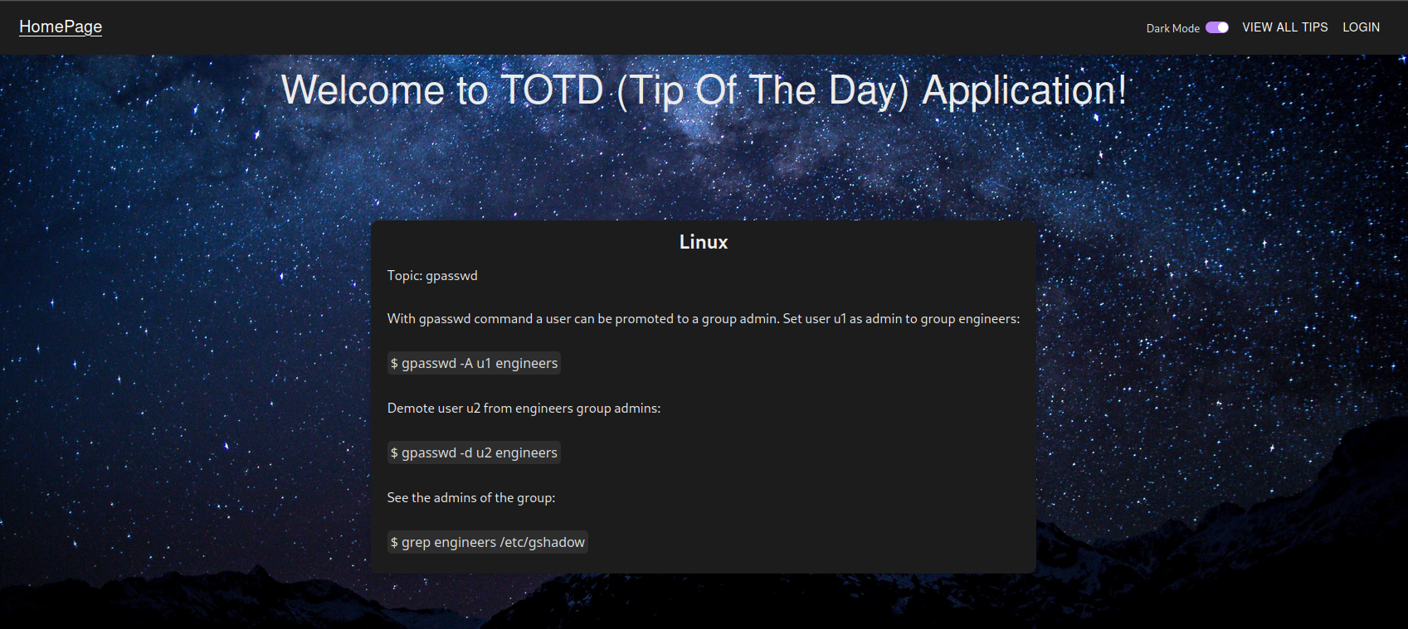
HomePage
Card that shows random tips and changes within time interval

Slide 3
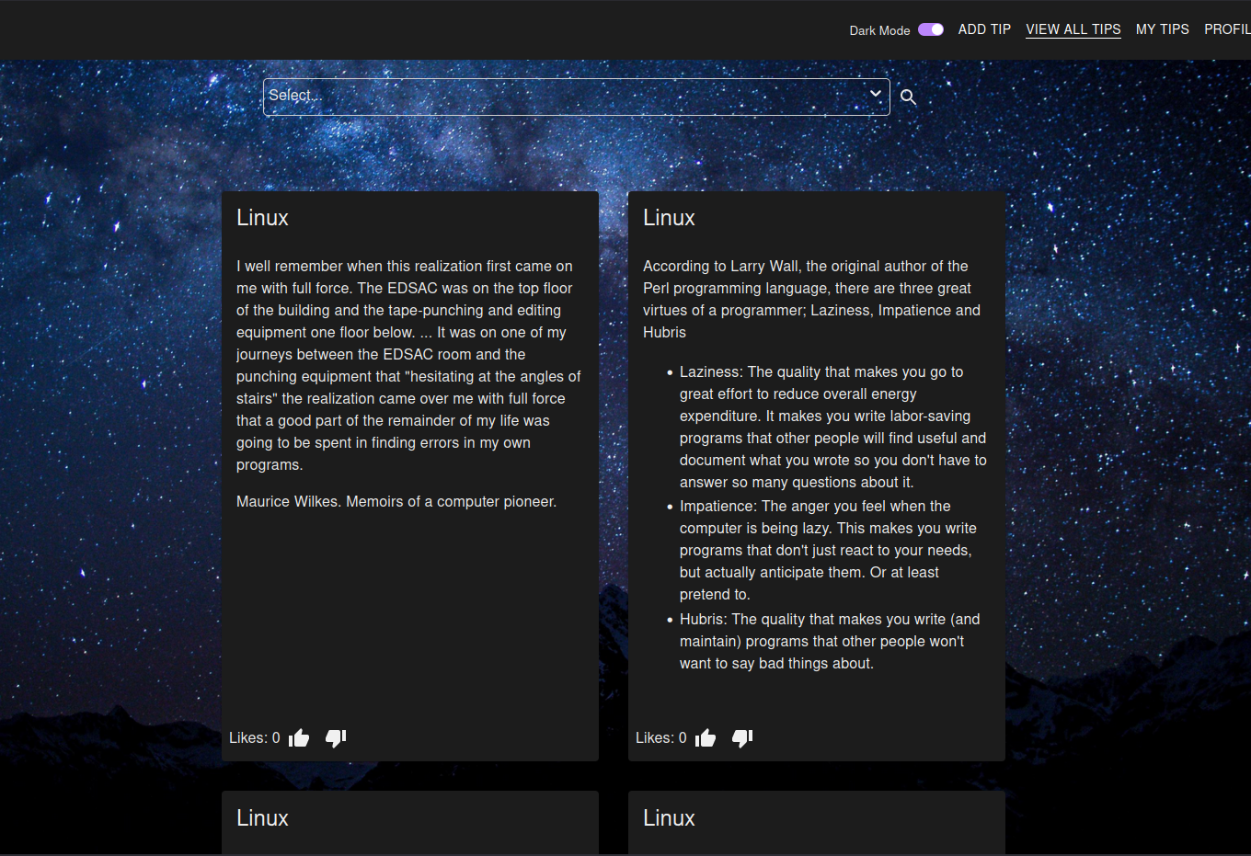
View all tips - page
Page where you can see all the tips. You can also filter them by category. This page is paginated and logged in user can like or dislike tips.

Slide 4
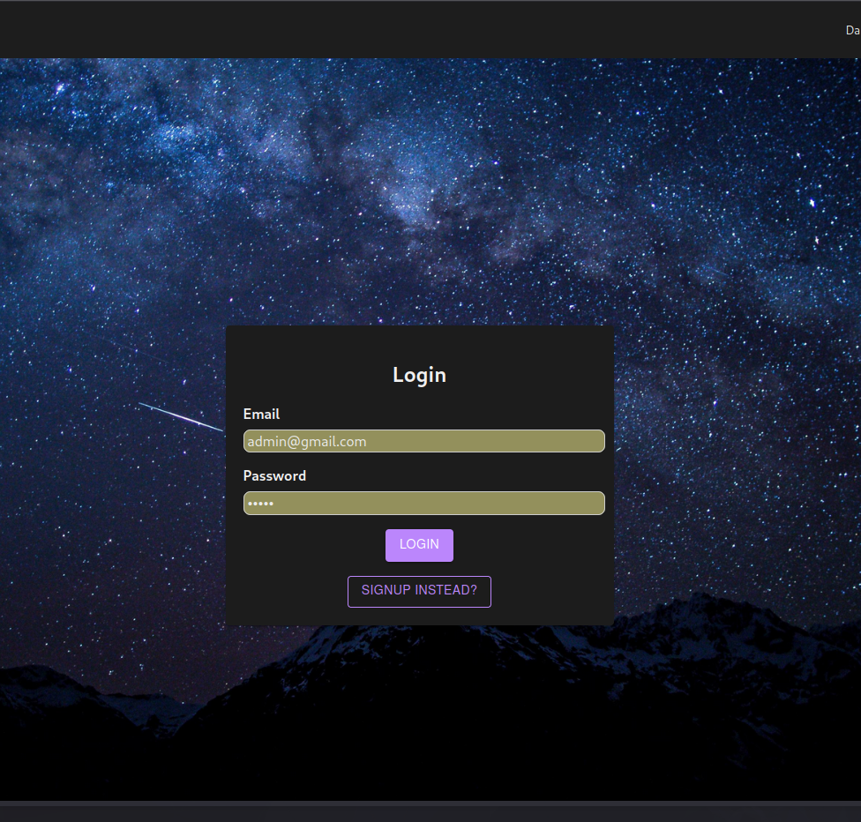
Login/signup - page
User can create an account and sign in. When signed user has access more functionalities that are shown in upcoming slides.

Slide 5
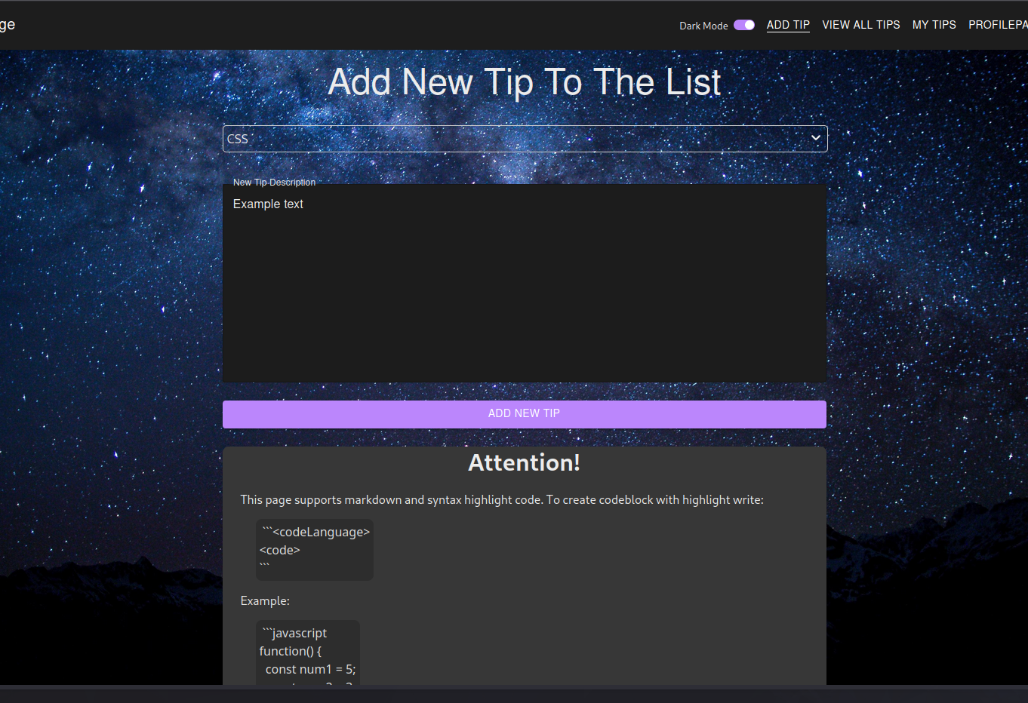
Add tip - page
Logged in user can create new tip. Tip must have set category and tips support markdown syntax.

Slide 6
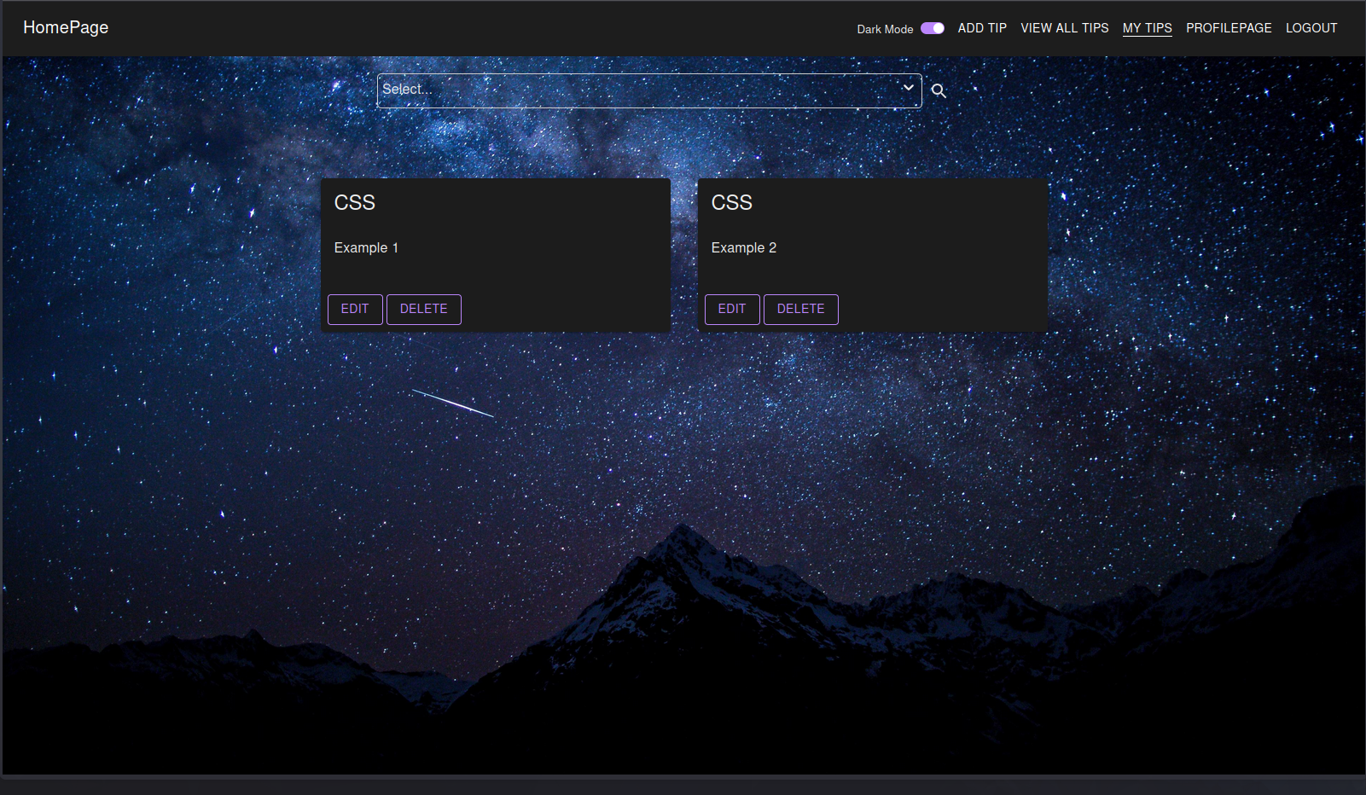
My tips - page
This page shows only tips that are created by logged in user. User can delete and edit own tips. User can also filter tips by category.

Slide 7
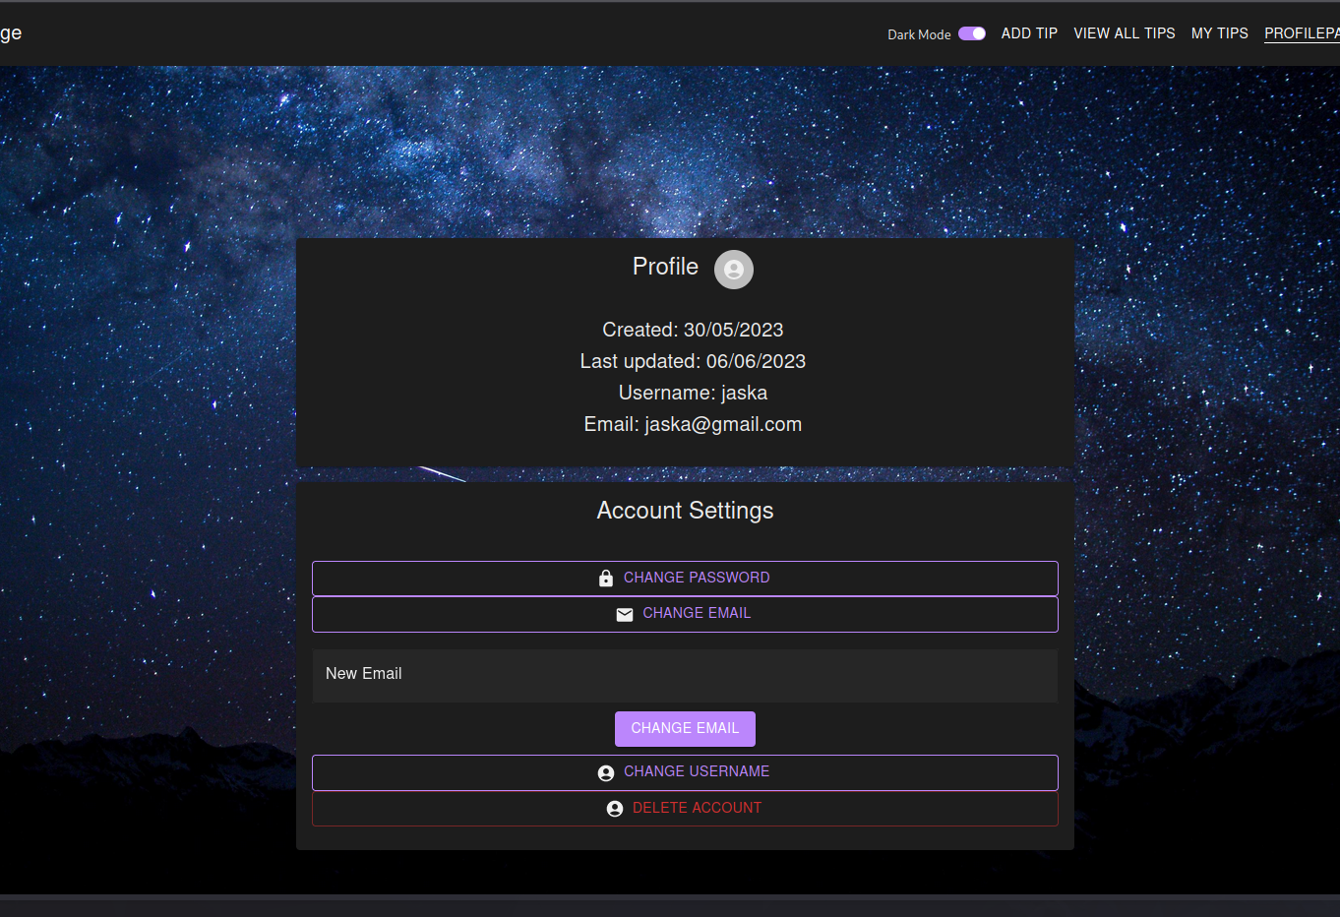
Profilepage
User can edit own profile information or delete own account.

Slide 8
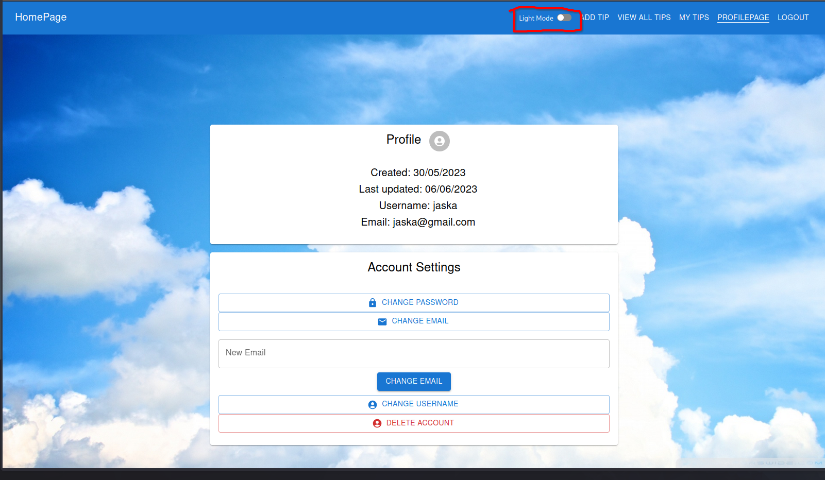
Theme option
Application has light and dark theme

Slide 9
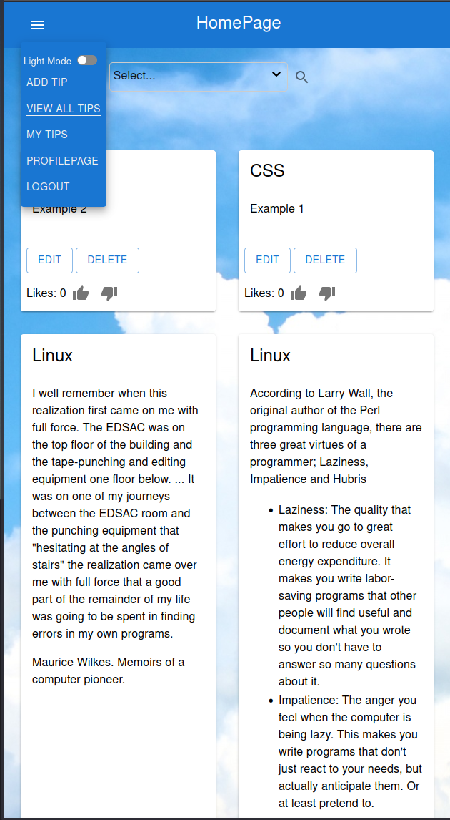
Application is responsive

Slide 10
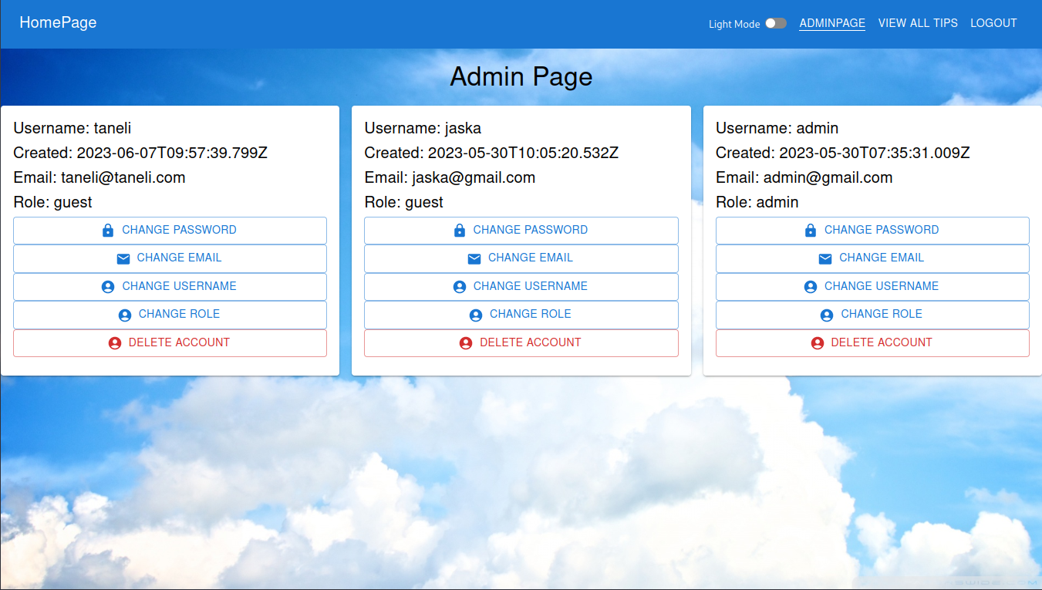
Admin
App has admin user that can edit and delete all the users and tips.

